Slide 1

Royal University of Phnom Penh
Computer Science department
A7-Y2-G24
TOPIC:
BLUETOOTH RC CAR
Presented By:
Korng Samnang
Chin Longhak
Sirath Vichika
Chhoun Sreypov
Tan Napha
Guide By:
Chea Samnang
(Professor)

Slide 2
CONTENTS:
INTRODUCTION
LIST OF COMPONENTS
PIN AND DEVICES CONNECTION
BLOCK DIAGRAM
REMOTE APP
VIDEO AND CODING
PRACTICE
DOWNLOAD PROJECT MATERIALS
QUESTIONS AND ANSWERS

Slide 3
1. INTRODUCTION
In this project, we are going to learn how to make a remote control car using the Arduino UNO microcontroller. We will be controlling using a mobile Android App via Bluetooth connection.

Slide 4
WHAT IS RC CAR ?
RC Car (Remote Control Car) is operated from a distant or remote location outside of the car.
This can be happened through a number of different methods, such as wire attached, Bluetooth connection, controller or controller that transmits signals via radio waves.

Slide 5
WHAT IS BLUETOOTH CONNECTION ?
Bluetooth is a short-rang wireless technology that enables the exchange of data between different devices using wavelength.
Bluetooth connection is a transmission between two Bluetooth devices. To complete the Bluetooth connection, you must first register the information of each device with the other. After paring the devices the first time, there is no need to repeat the pairing process to connect again.

Slide 6
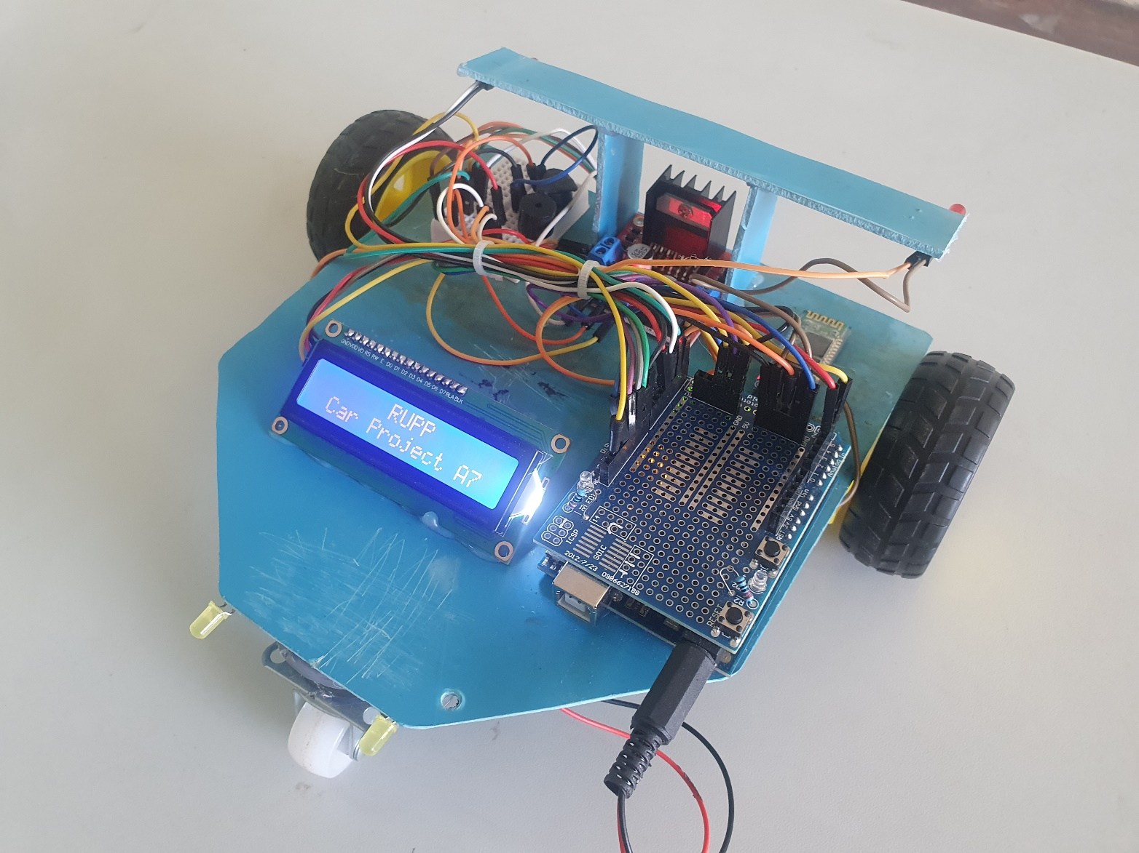
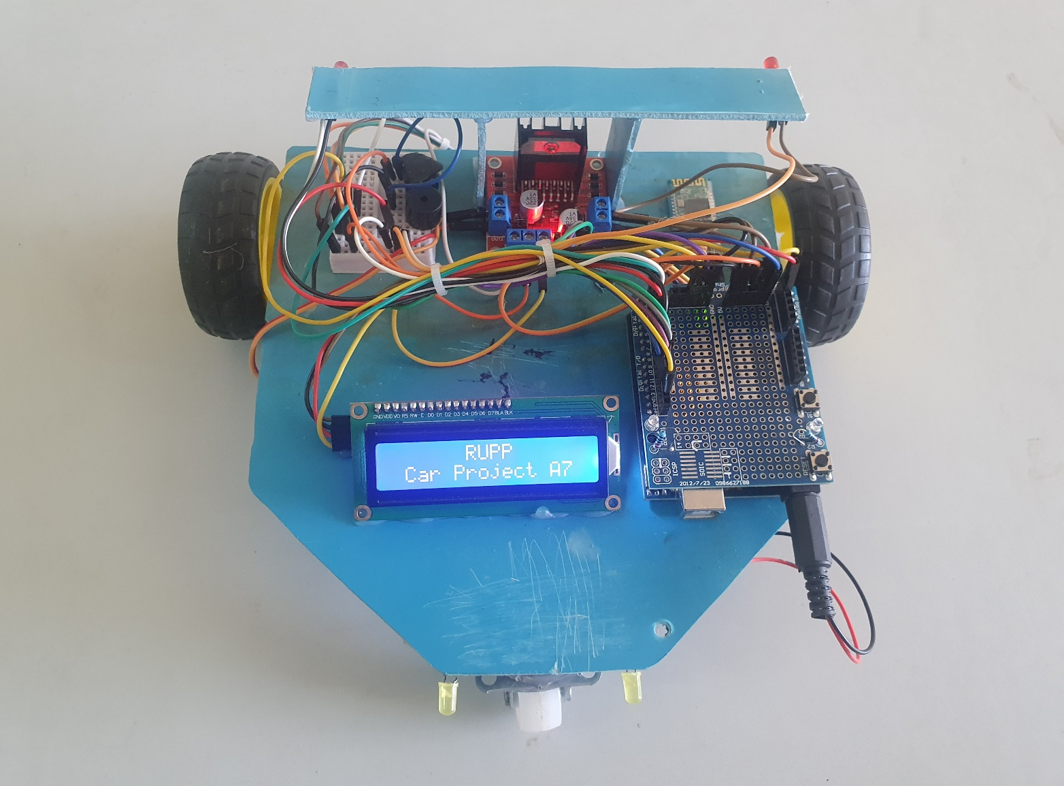

Slide 7
2. LIST OF COMPONENTS
Main components
Power supply
Arduino UNO x1
Motor Driver x1
Gear Motor x2
HC-06 Bluetooth Module x1
Rubber Wheel x2
Caster Wheel x1
Battery holder 2 slot x1
Battery 3.7v x2
Battery holder 6 slot x1
Battery 1.5v x6

Slide 8
Addition components (optional)
I2C LCD x1
LED x4
Buzzer x2
Mini Breadboard x1

Slide 9
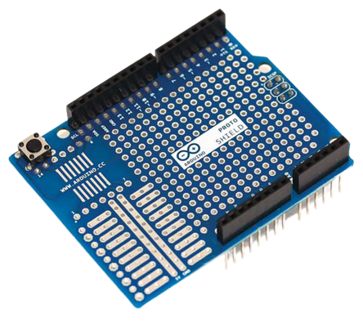
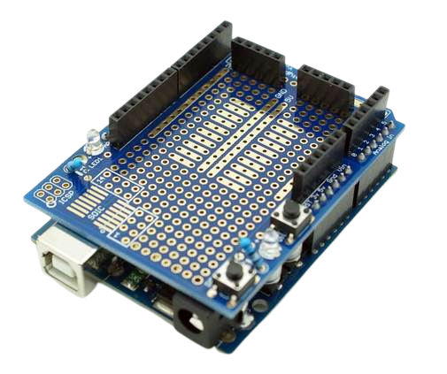
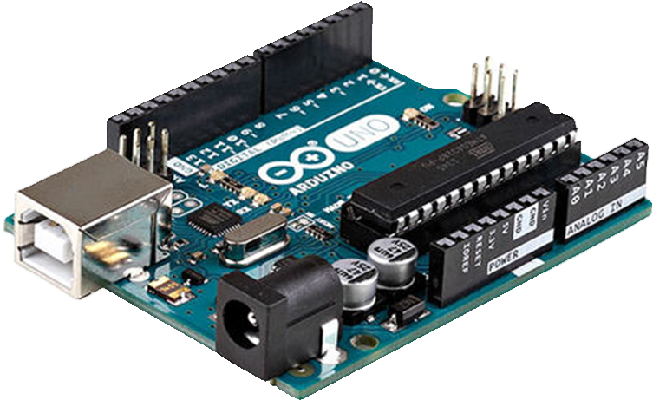
Arduino UNO
Proto-shield
Arduino Uno is a microcontroller board based on the ATmega328P. The Arduino UNO board is used for an electronics project and mostly preferred by the beginners.
Shields are pieces of hardware that sit on top of your Arduino, often to give it a specific purpose.

Slide 10
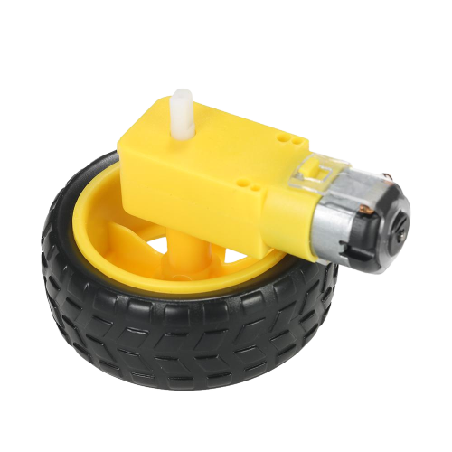
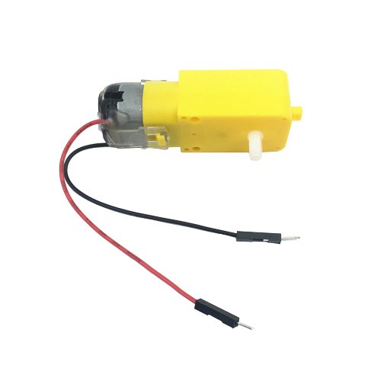
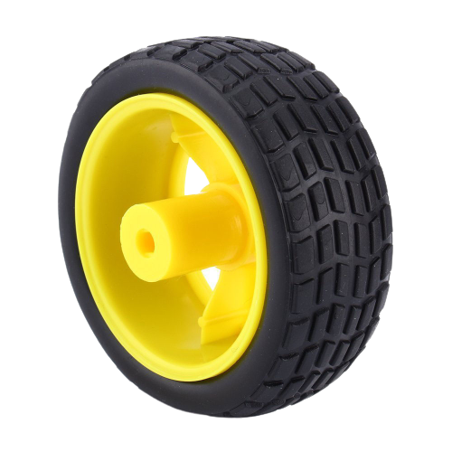
Gear Motor
Rubber Wheel
Gear motor is a specially designed DC motor whose gear assembly helps in increasing the torque and reducing the speed.
Gear Motor is connected to Arduino UNO via motor driver.

Slide 11
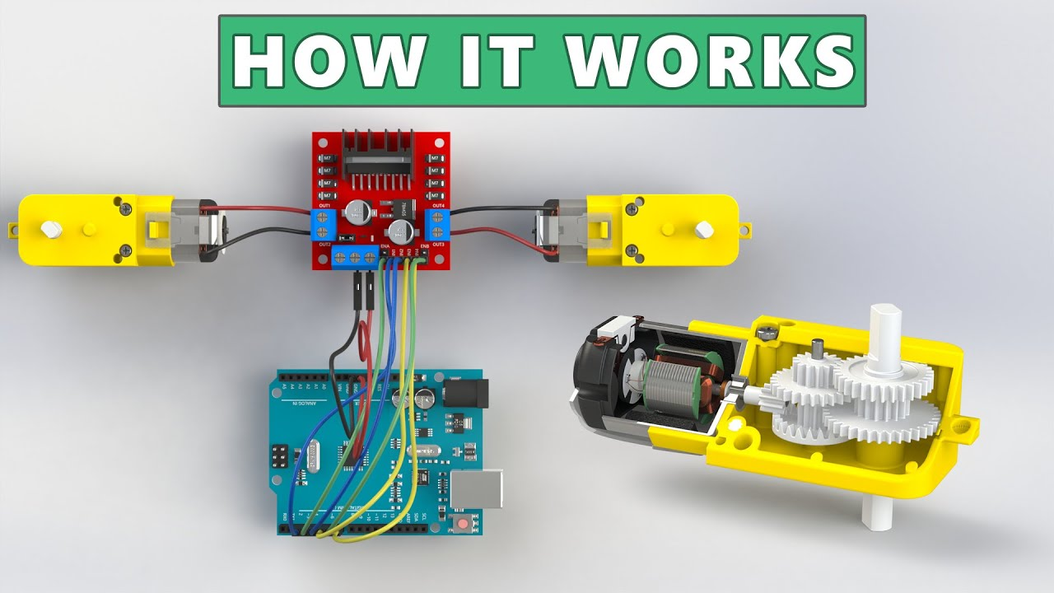
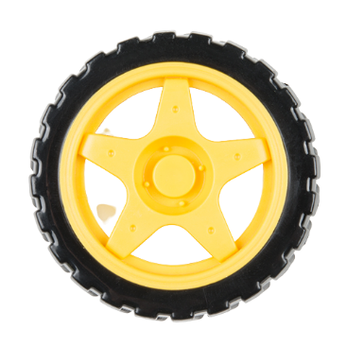
Arduino Uno
Inside
Gear motor
Gear Motor
Gear Motor
L298N Motor driver
A motor driver means a device that drives motors. The L298N Motor Driver is a controller that uses to control the direction and speed of two motors simultaneously.

Slide 12
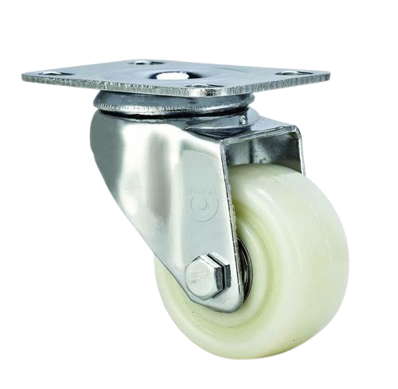
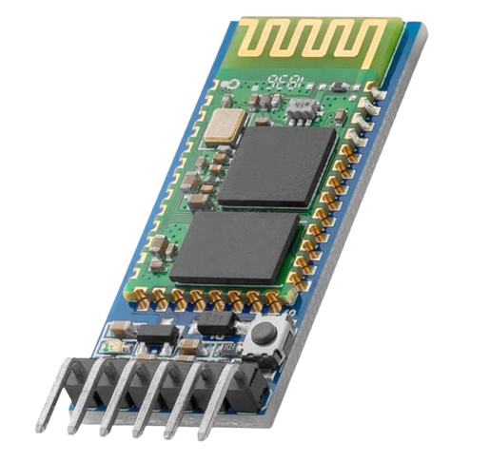
HC-06 Bluetooth Module
Caster Wheel
HC-06 is a Bluetooth module designed for establishing short range wireless data communication (<100 meters)

Slide 13
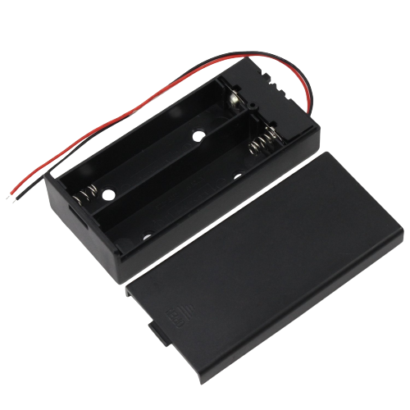
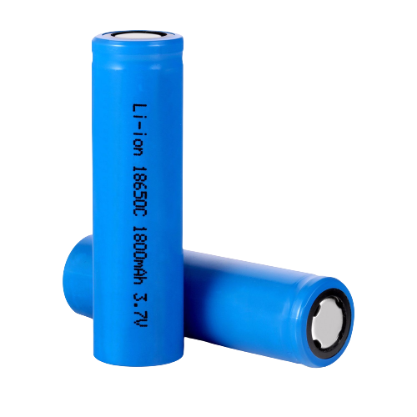
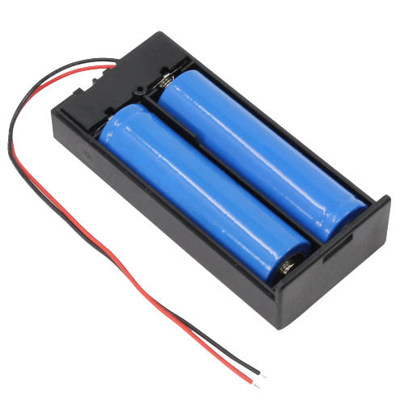
Power supply
Battery holder 2 slot
Battery 3.7v
For Motor Driver

Slide 14
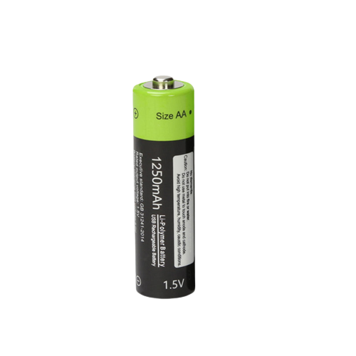
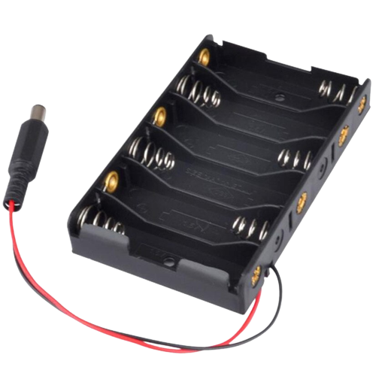
Battery holder 6 slot
1.5v Battery
For Arduino

Slide 15
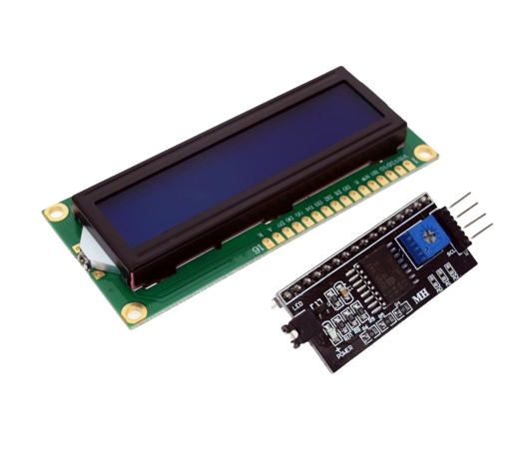
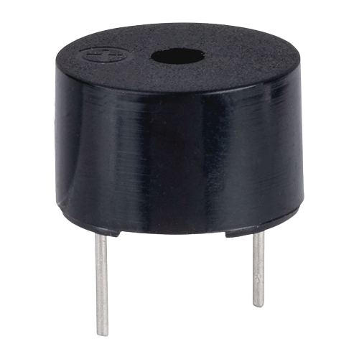
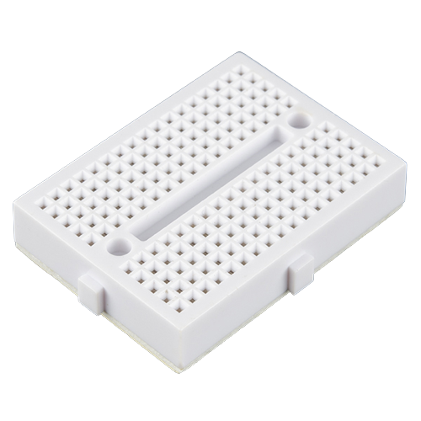
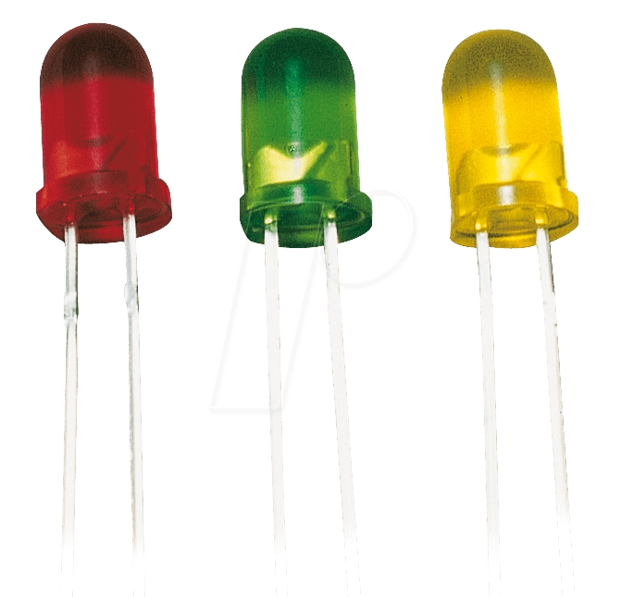
LCD
Buzzer
LED
Mini Breadboard
i2c
This is a 16x2 LCD display screen with I2C interface. It is able to display 16x2 characters on 2 lines, white characters on blue background.
Buzzer is basically a tiny speaker that you can connect directly to an Arduino. You can make it sound a tone at a frequency you set.
LEDs or Light-emitting diode are small, powerful lights that are used in many different applications.
A breadboard allows for easy and quick creation of temporary electronic circuits or to carry out experiments with circuit design.

Slide 16
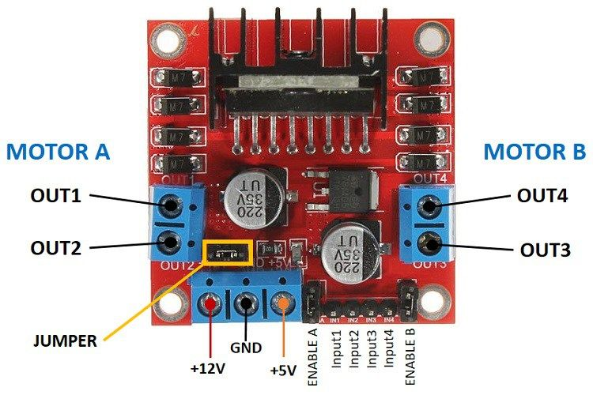
3. PIN AND DEVICES CONNECTION
Connect Gear motor with Motor driver to Arduino
Motor Driver | Arduino
GND | GND
5V | 5V
INP1 | PIN12
INP2 | PIN11
INP3 | PIN10
INP4 | PIN9

Slide 17
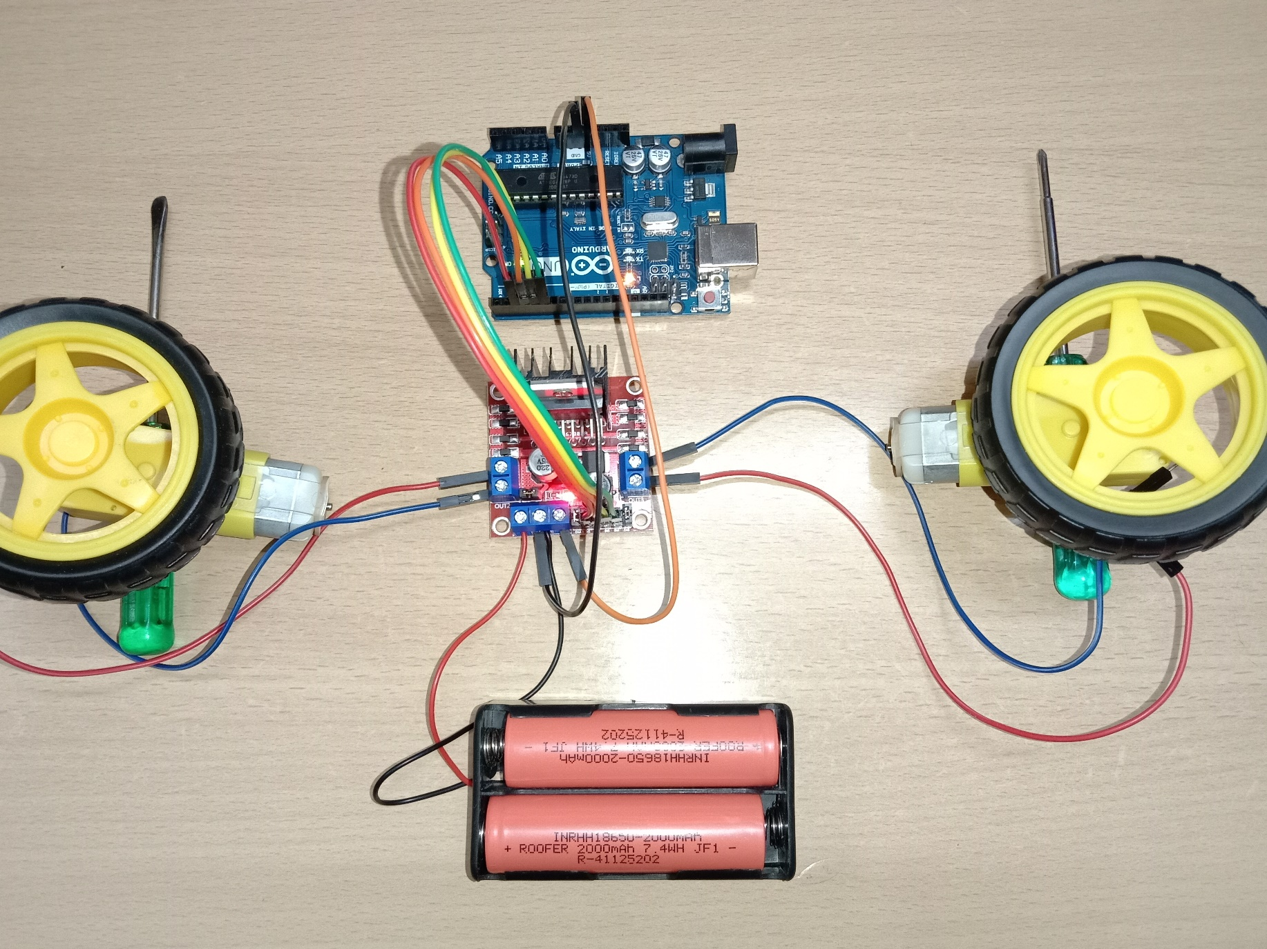

Slide 18
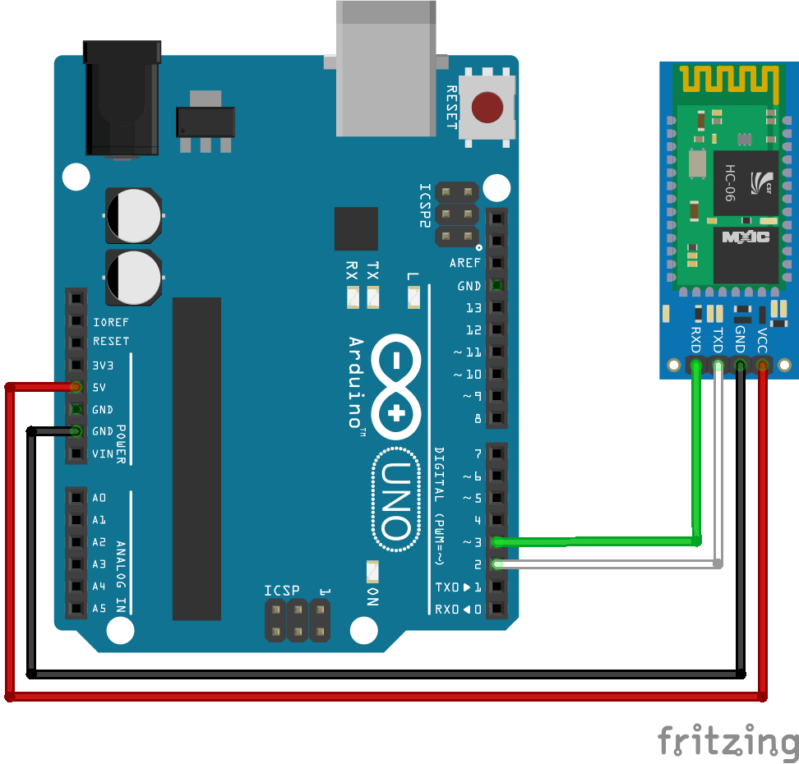
Connect HC-06 Bluetooth to Arduino
Bluetooth | Arduino
VCC | 5V
GND | GND
TXD | PIN2
RXD | PIN3

Slide 19
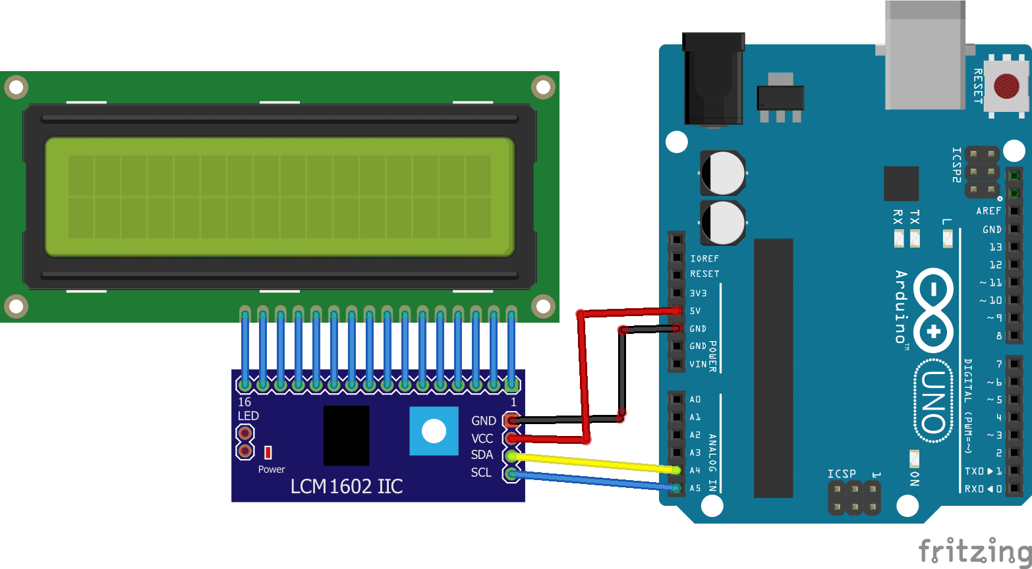
Connect lcd i2c to Arduino
I2C | Arduino
GND | GND
VCC | 5V
SDA | A4
SCL | A5

Slide 20
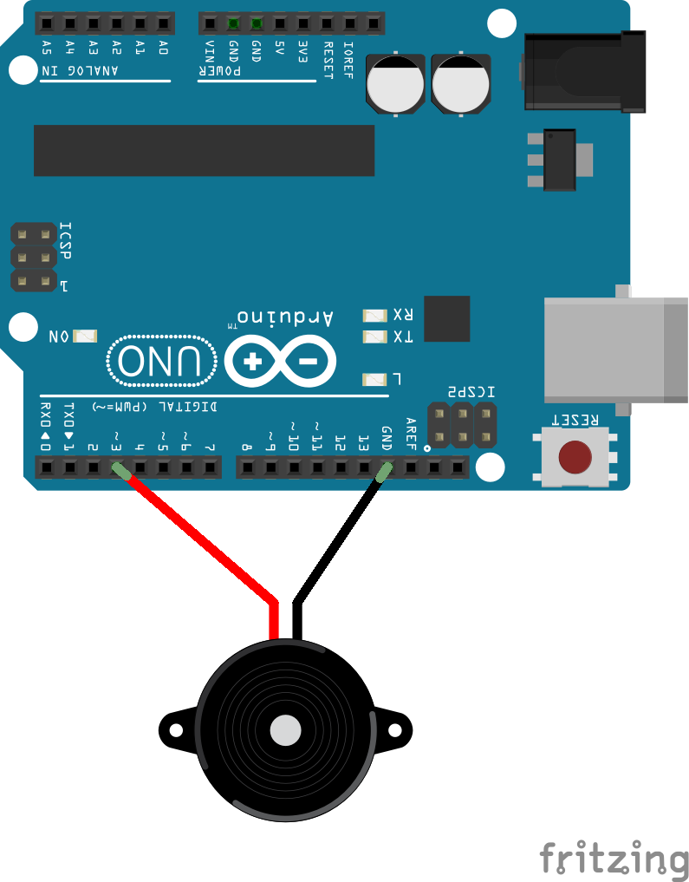
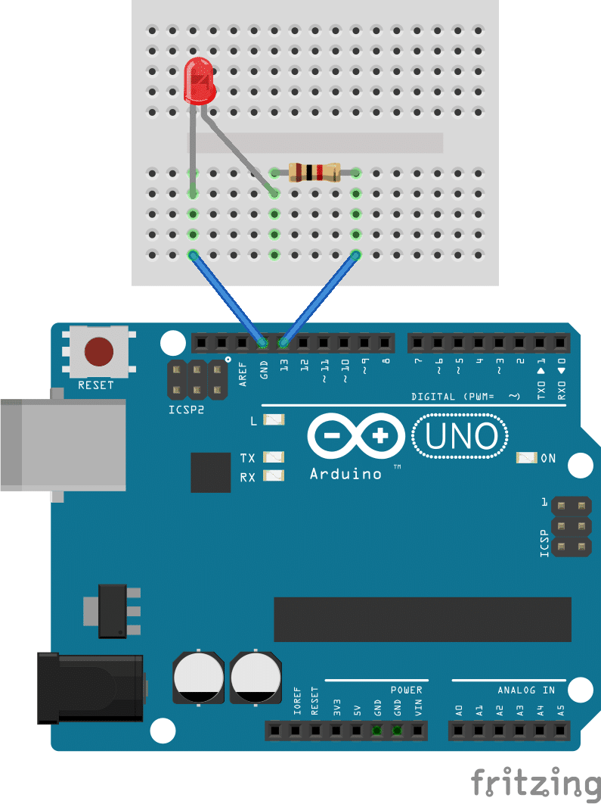
Connect Buzzer to Arduino
Connect LED to Arduino

Slide 21
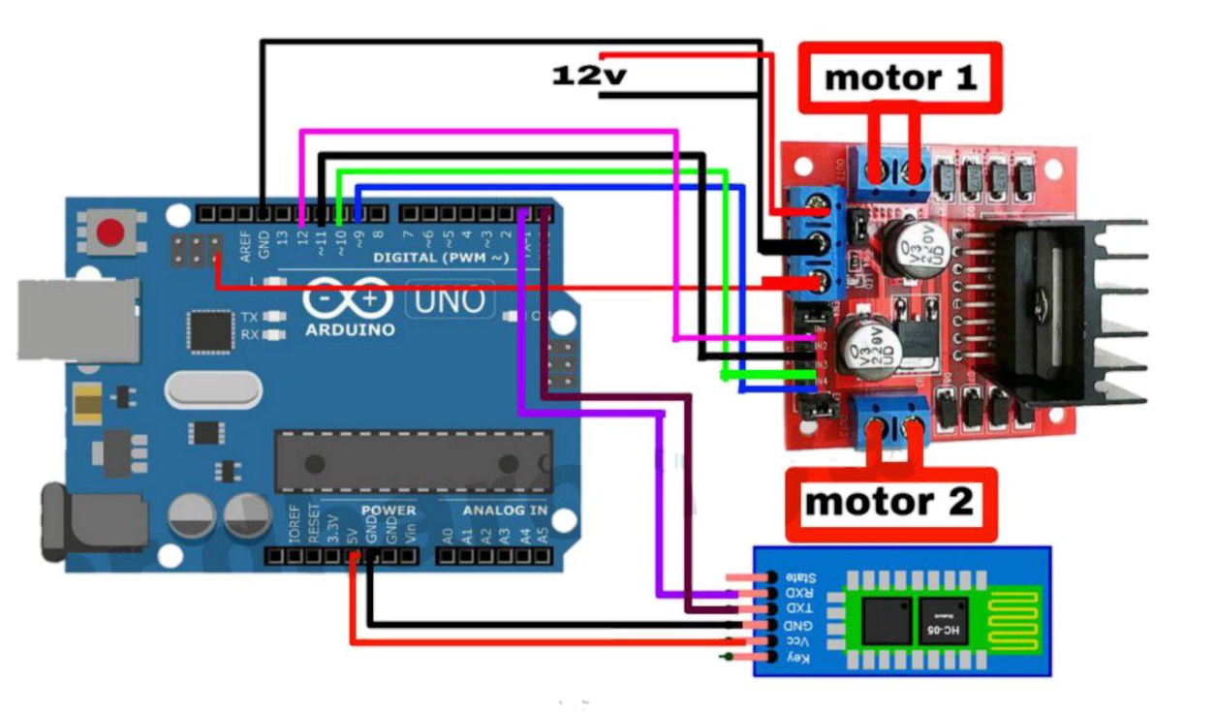
4. BLOCK DIAGRAM

Slide 22
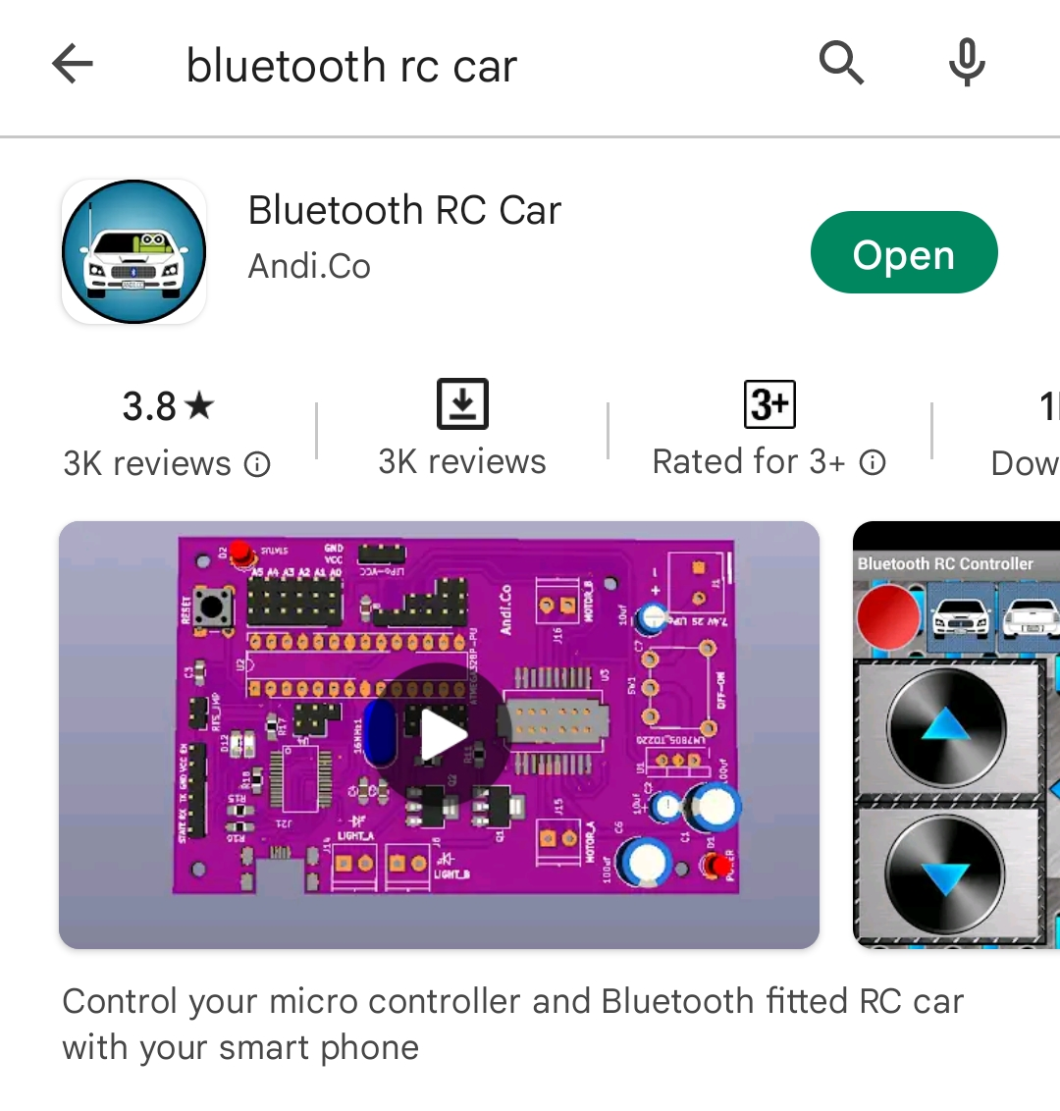
5. REMOTE APP
Download this app from Google Play Store

Slide 23
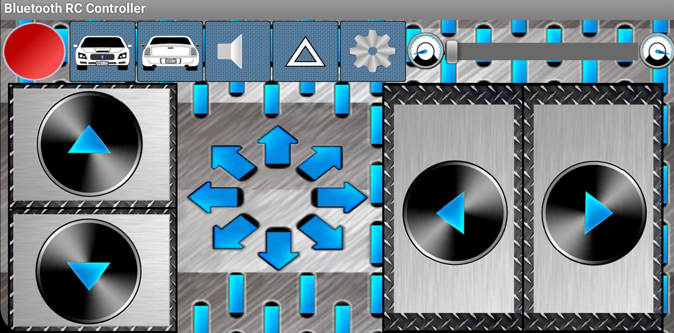
Back-light
Trumpet
Music
Setting
Front-light
Bluetooth connection status
Forward
Backward
Right
Left

Slide 24
6. VIDEO AND CODING

Slide 25
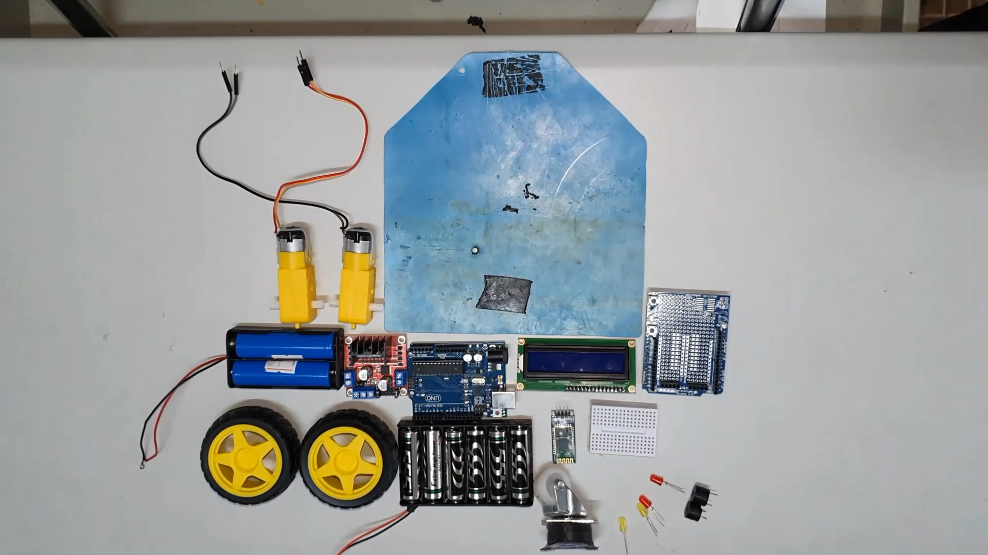

Slide 27
7. PRACTICE

Slide 28
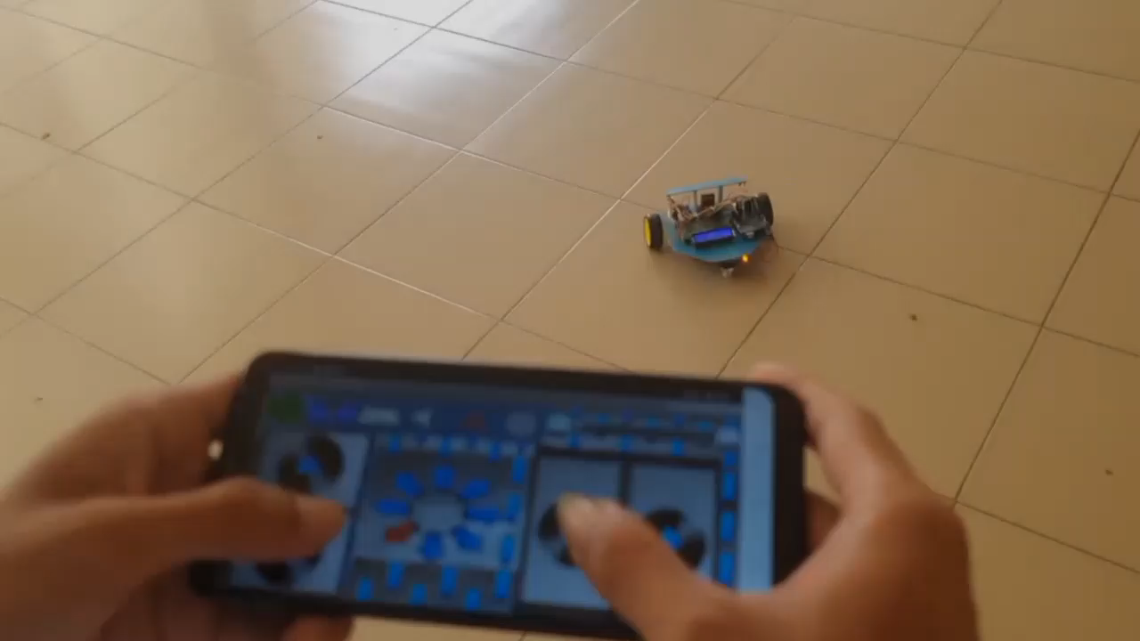

Slide 29
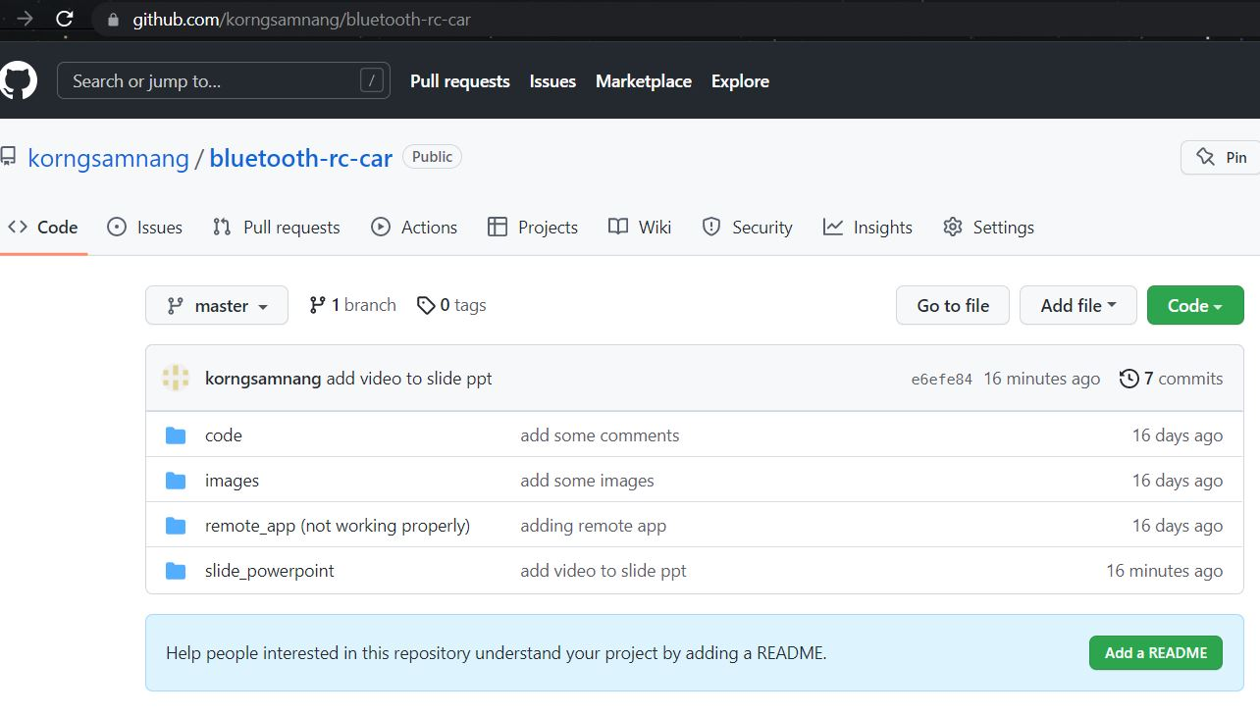
8. DOWNLOAD PROJECT MATERIALS
https://github.com/korngsamnang/bluetooth-rc-car

Slide 30
9. Q&A

